Slide 1


Principle of Computer Networks Experiment - Lesson 3
Lecture: Bo Yang
Professor at School of CS
Northwestern Polytechinal University
Fall semester 2022
yang_bo@nwpu.edu.cn

Slide 2
Goals
1. Matlab overview
2. TCP Connections via Matlab
3. UDP Connections via Matlab

Slide 3
Goals
1. Matlab overview
2. TCP Connections via Matlab
3. UDP Connections via Matlab

Slide 4
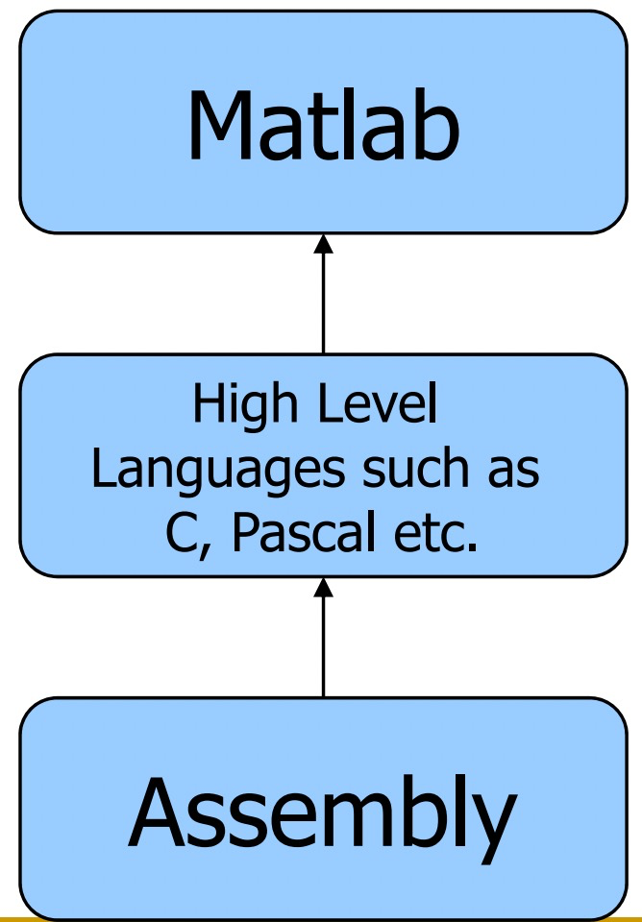

What is Matlab?
Matlab is basically a high level language which has many specialized toolboxes for making things easier for us!

Slide 5
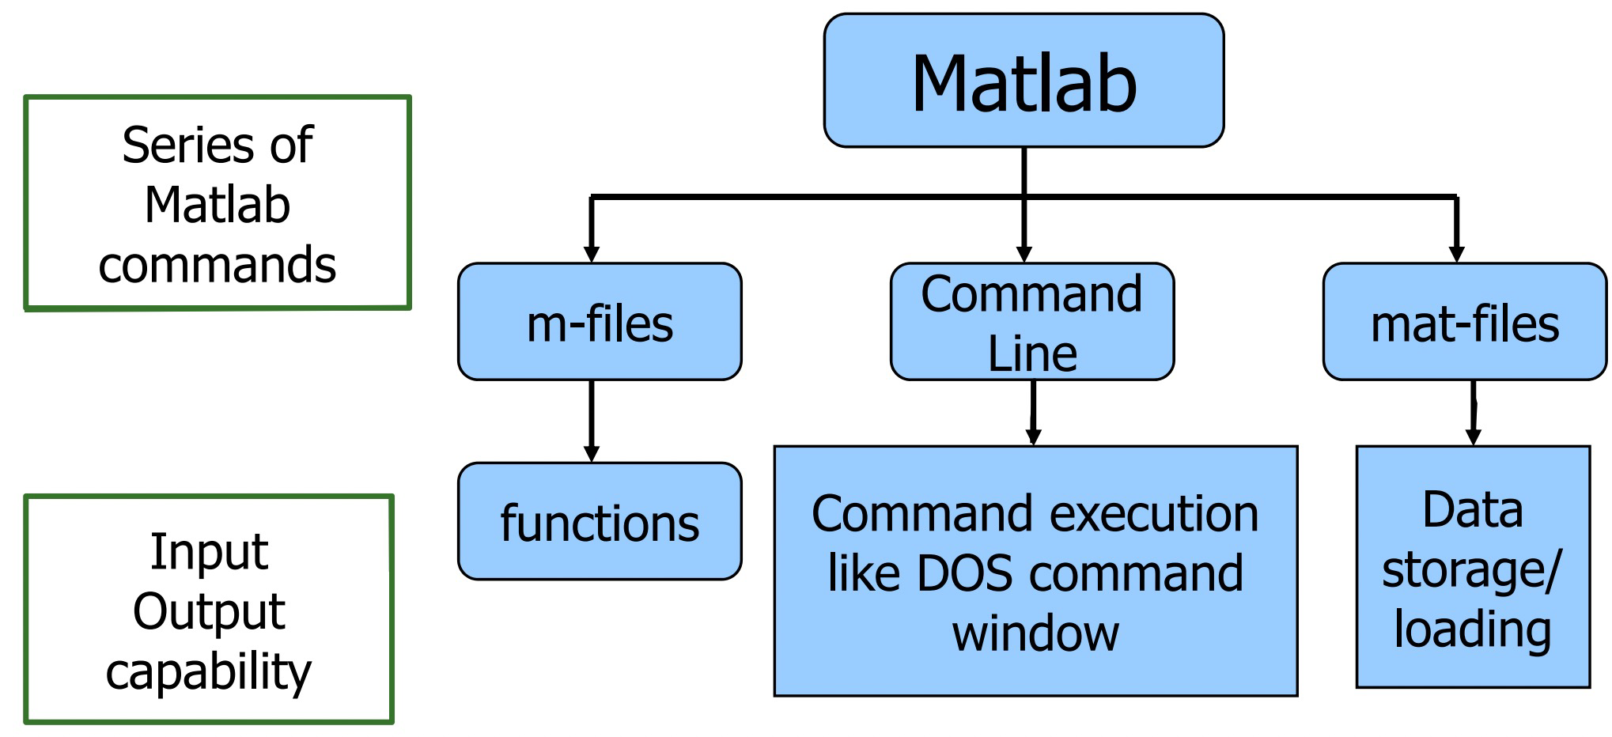



What are we interested in?
Matlab is too broad for our purposes in this course
The features we are going to require is

Slide 6
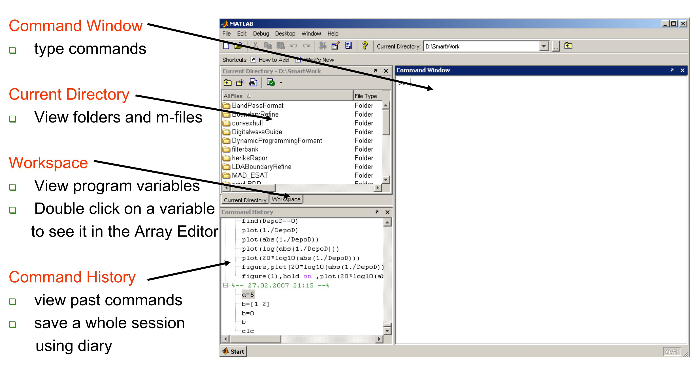


Matlab Screen (show me yours...)

Slide 7
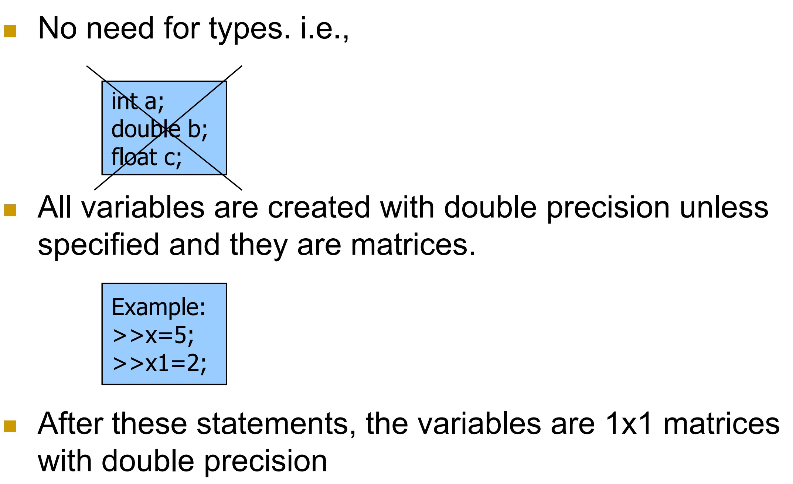
Variables

Slide 8
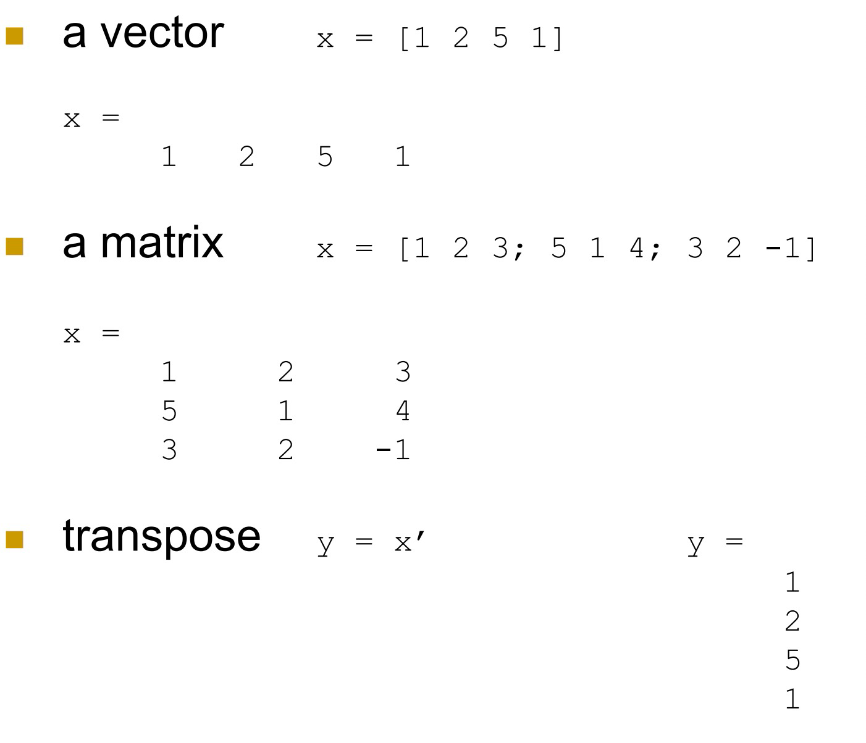

Array and Matrix

Slide 9
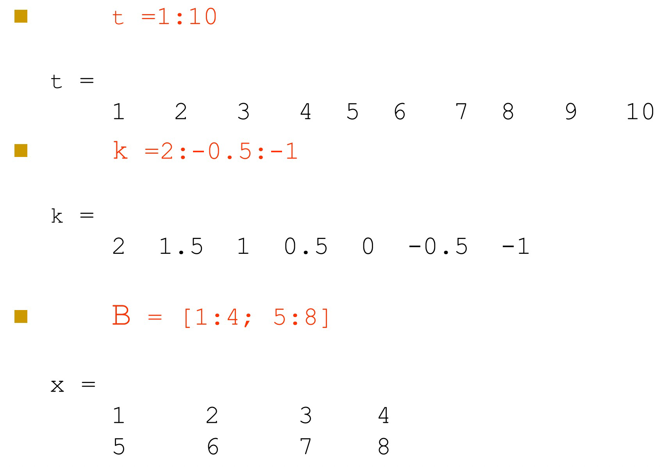
Long Array Matrix

Slide 10
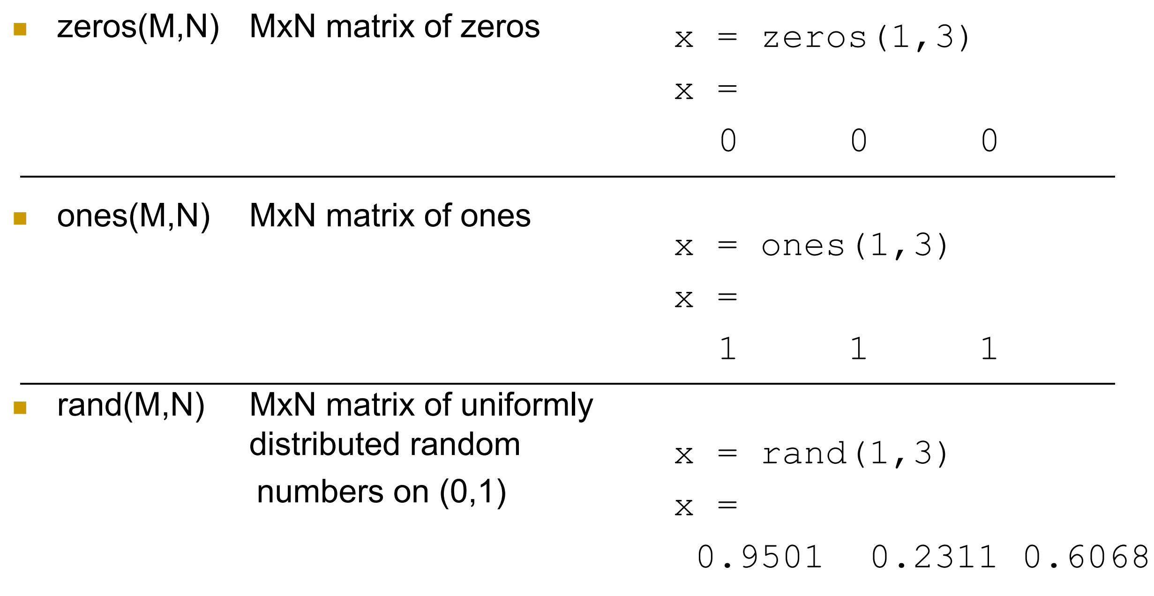
Generating Vectors from functions

Slide 11
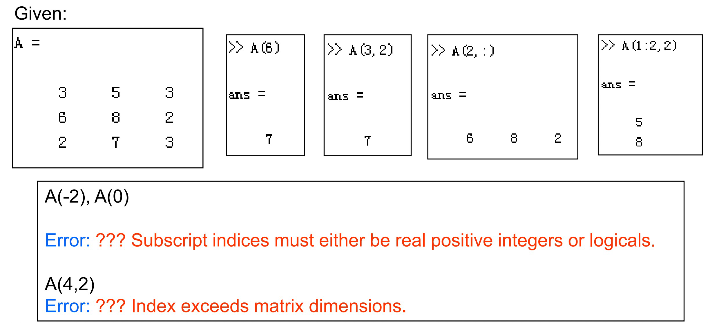
Matrix Index
The matrix indices begin from 1
The matrix indices must be positive integer

Slide 12
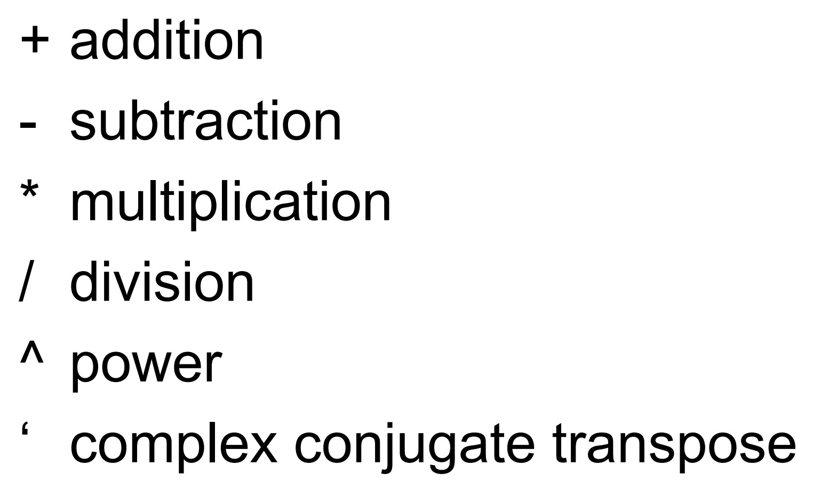
Operators (arithmetic)
Go and Try them!

Slide 13
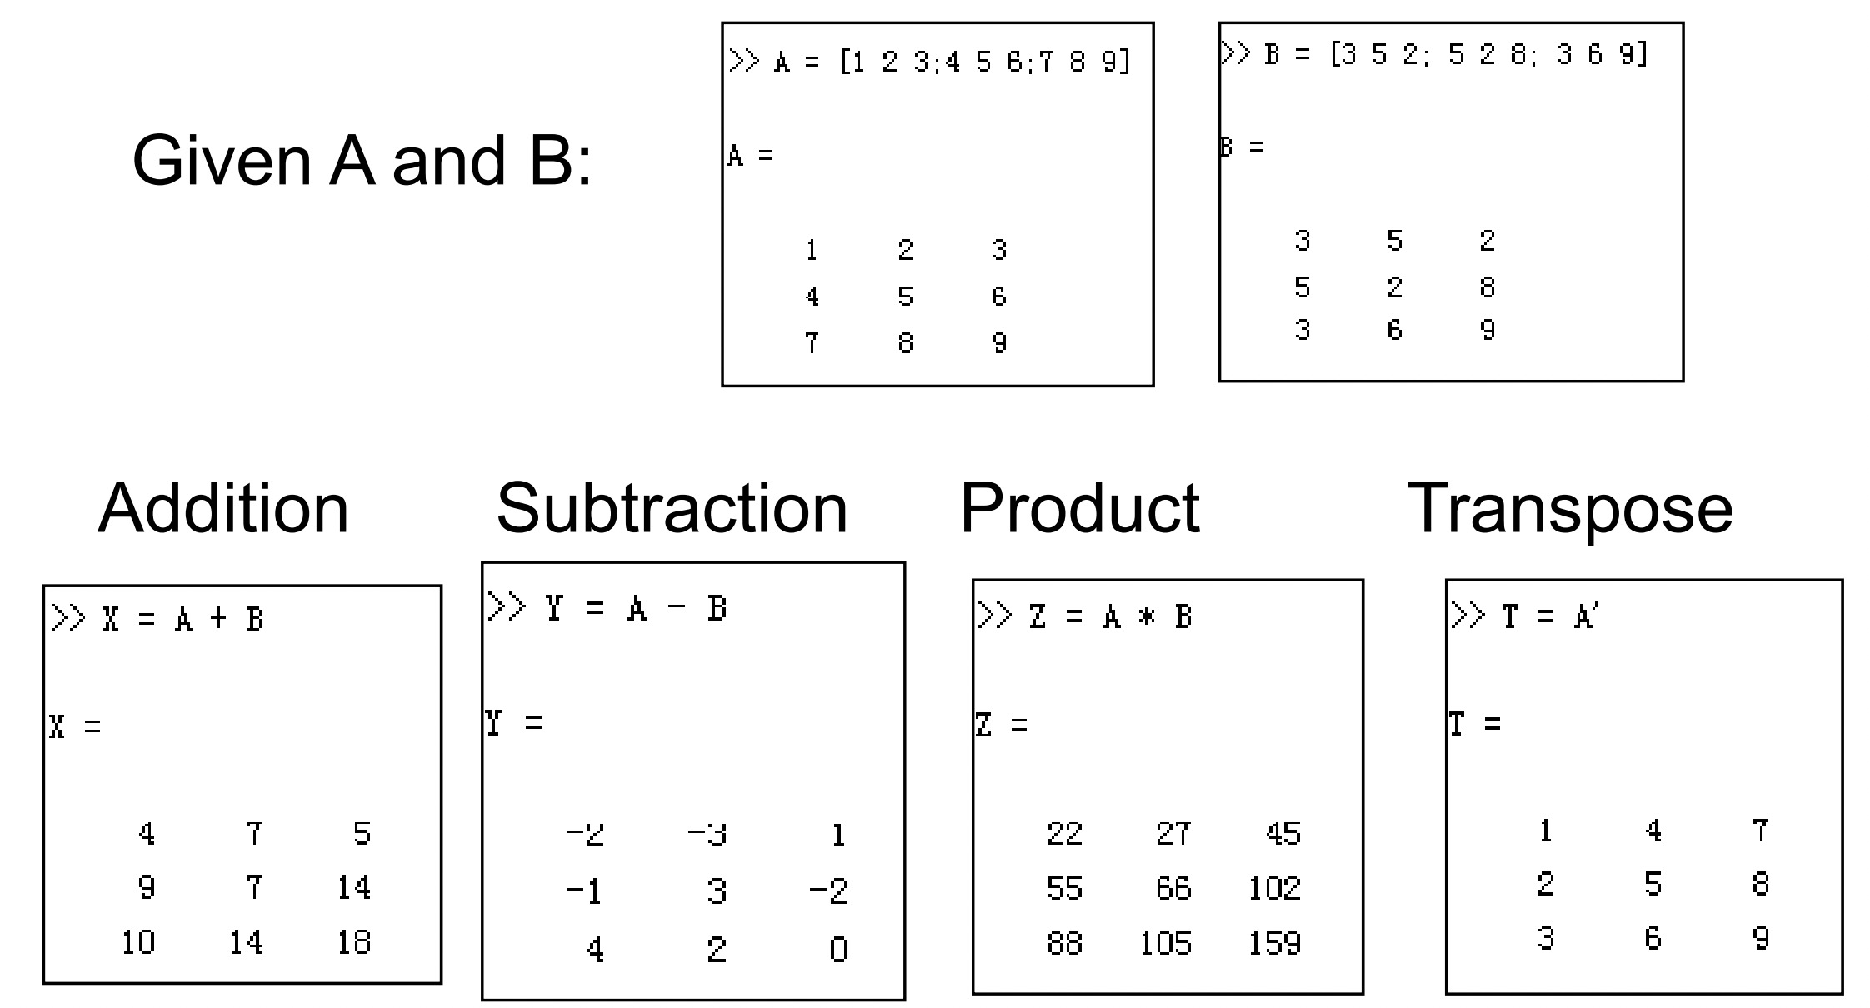






Matrices Operations
Go and Try them!

Slide 14
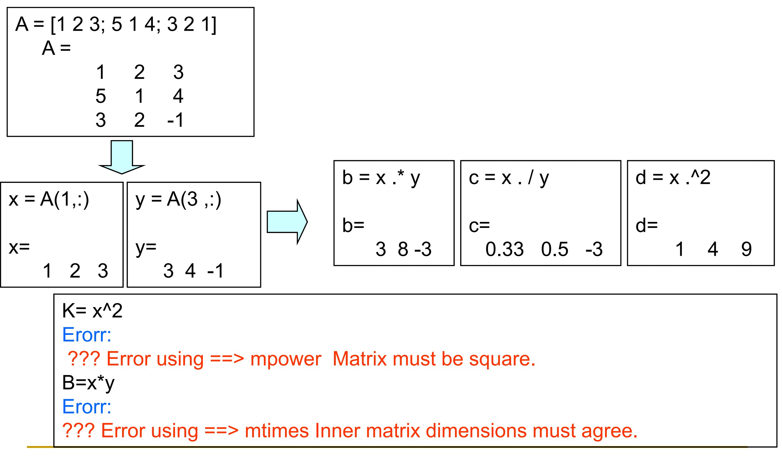
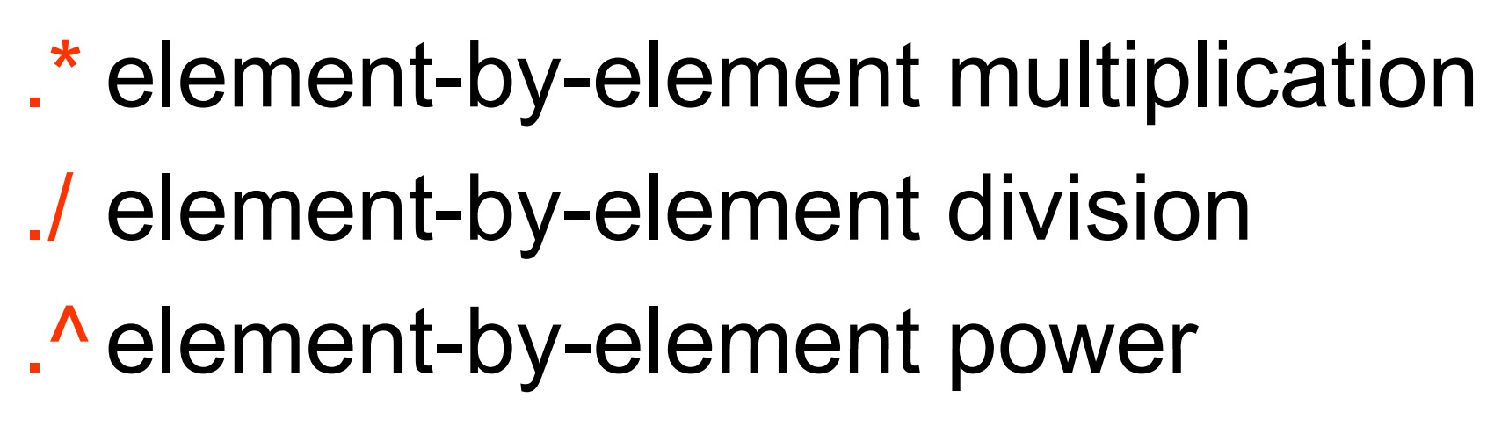
Operators (Element by Element)
Go and Try them!

Slide 15
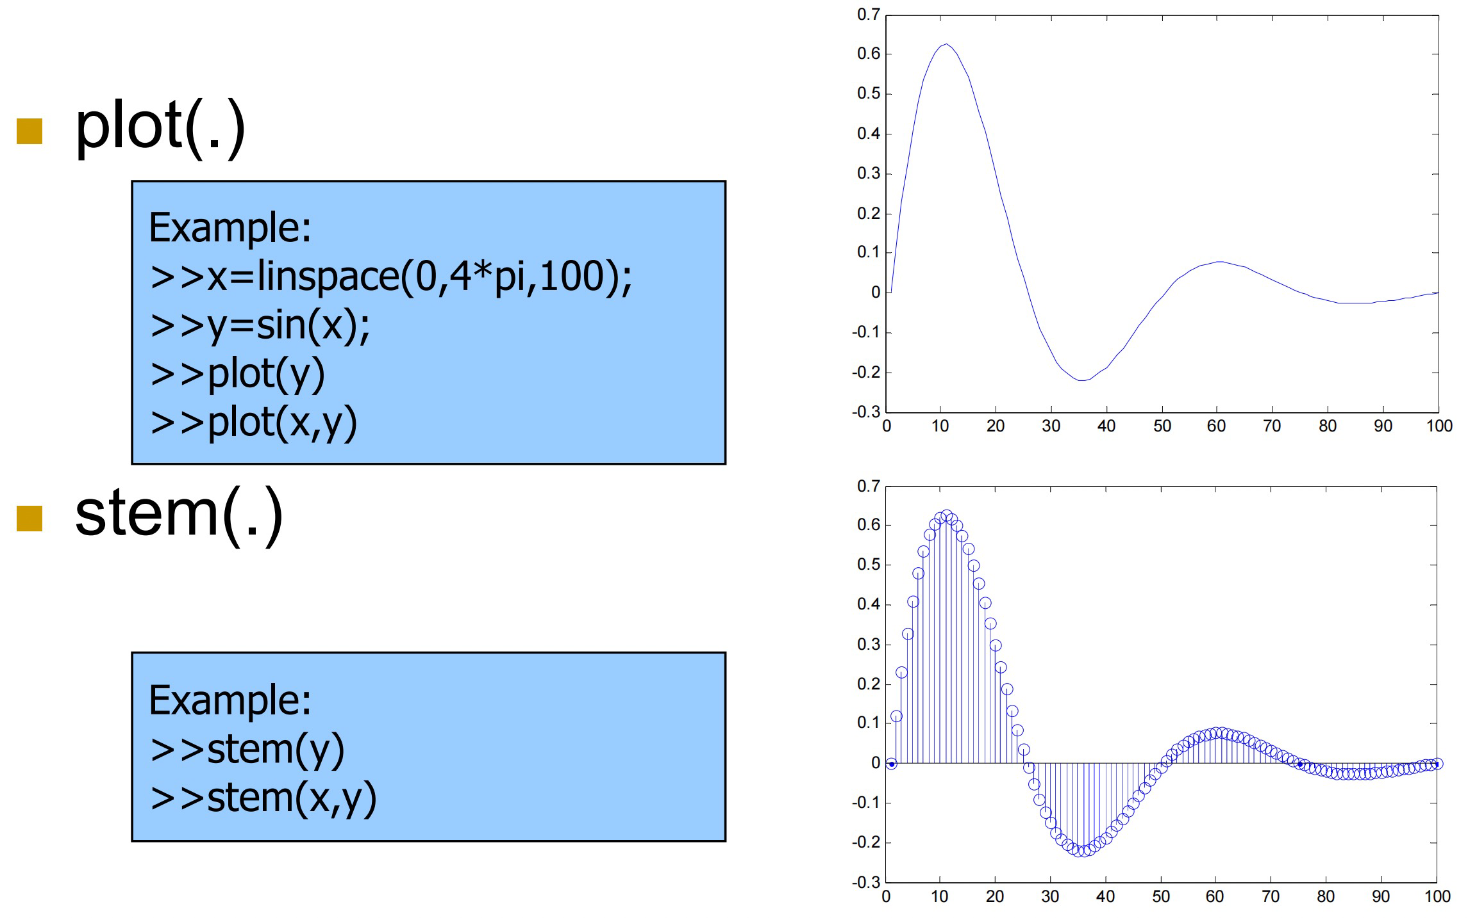
Display Facilities
Go and Try them!
Create an x-array of 100 samples
between 0 and 4 and 4π.

Slide 16
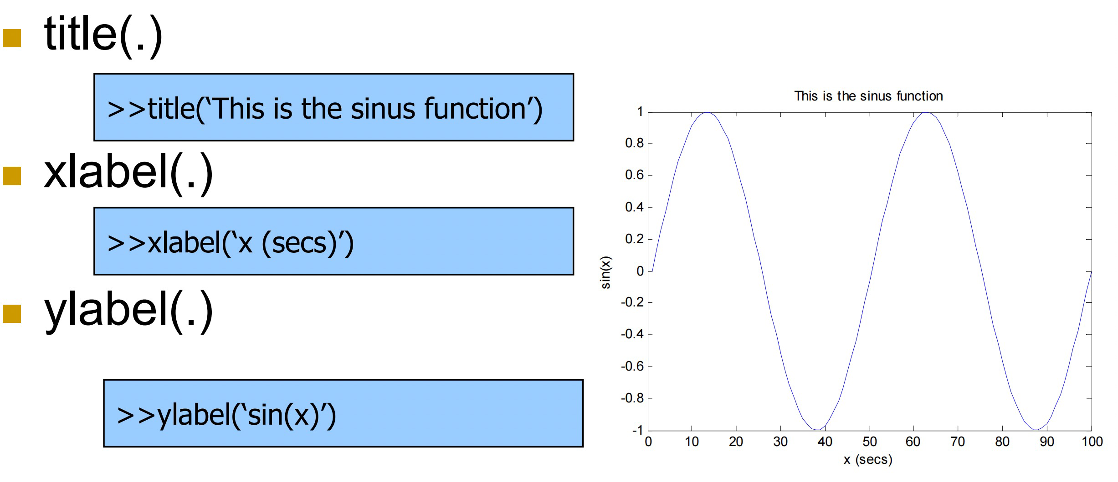
Display Facilities
Go and Try them!

Slide 17
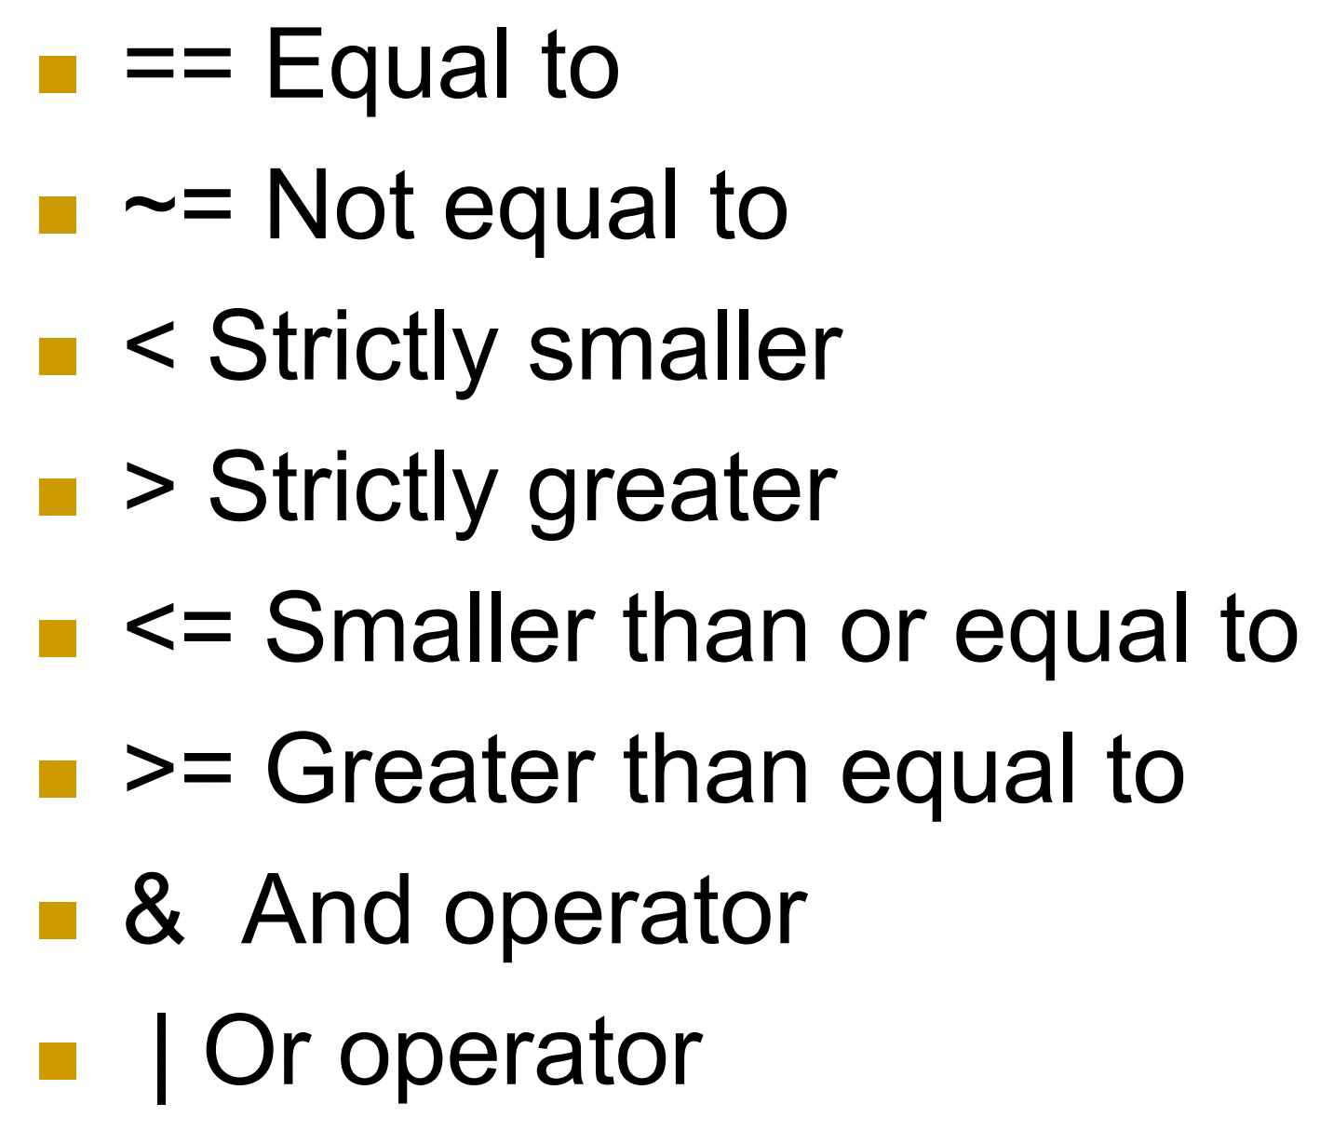
Operators (relational logical)
Go and Try them!

Slide 18
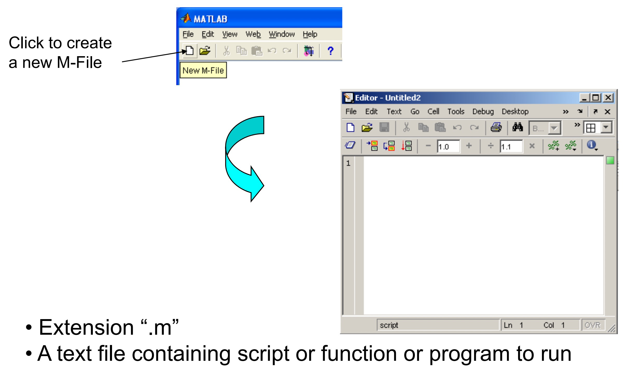
Use of M Use of M-File

Slide 19
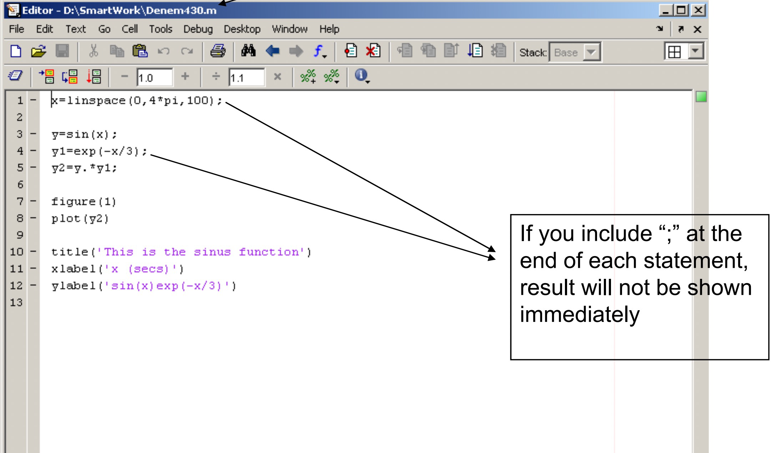
Use of M Use of M-File

Slide 20
Goals
1. Matlab overview
2. TCP Connections via Matlab
3. UDP Connections via Matlab

Slide 21
TCP/IP Communication Overview
Overview
Transmission Control Protocol (TCP) is a transport protocol layered on top of the Internet Protocol (IP) and is one of the most used networking protocols.
The TCP/IP client support uses raw socket communication and lets you connect to remote hosts from MATLAB for reading and writing data.
For example, you can connect to a remote weather station, acquire data, and plot the data.

Slide 22
TCP/IP Communication Overview
Features:
Connection-oriented: The two ends of the communication link must be connected at all times during the communication.
Streaming: TCP/IP has a long stream of data that is transmitted from one end of the connection to the other end, and another long stream of data flowing in the opposite direction.
The TCP/IP stack at one end is responsible for breaking the stream of data into packets and sending those packets, while the stack at the other end is responsible for reassembling the packets into a data stream using information in the packet headers.

Slide 23
TCP/IP Communication Overview
Features:
Reliable: The packets sent by TCP/IP contain a unique sequence number. The starting sequence number is communicated to the other side at the beginning of communication.
The receiver acknowledges each packet, and the acknowledgment contains the sequence number so that the sender knows which packet was acknowledged. Because the sender gets an acknowledgement for each packet received, the sender knows when packets do not arrive and can retransmit them. Also, packets that arrive out of sequence can be reassembled in the proper order by the receiver.
Timeouts: timeouts can be established because the sender knows (from the first few packets) how long it takes on average for a packet to be sent and its acknowledgment received.

Slide 24
Create TCP/IP Client and Configure Settings
The typical TCP workflow
Create a TCP/IP connection to a server.
Configure the connection if necessary.
Perform read and write operations.
Clear and close the connection.

Slide 25
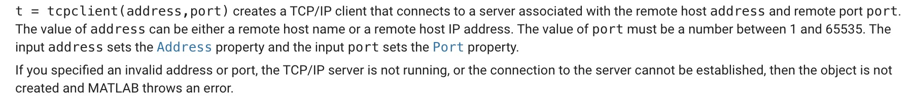
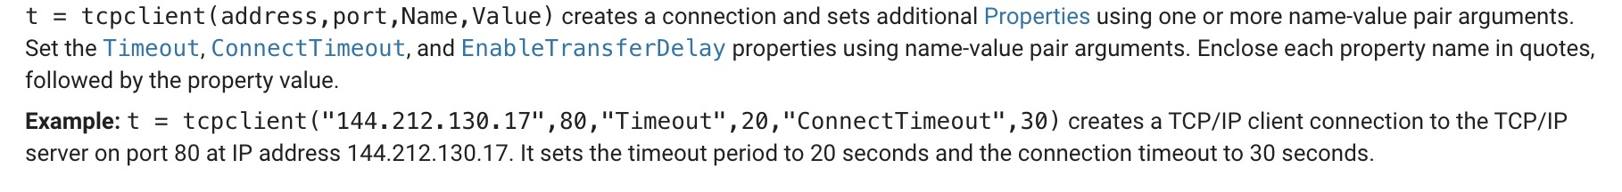





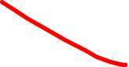
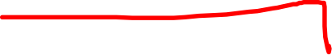


Create a TCP/IP connection to a server
1. Creation: create a TCP/IP connection to a server
tcpclient
A tcpclient object represents a connection to a remote host and remote port to read and write data. The remote host can be a server or hardware that supports TCP/IP communication, and must already exist.
The tcpclient object is always the client and cannot be used as a server.

Slide 26
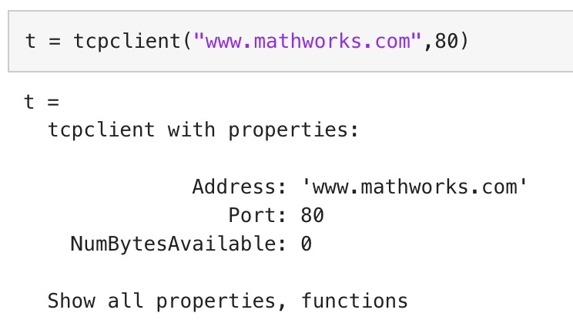

Create a TCP/IP connection to a server
1. Creation: create a TCP/IP connection to a server
Create Object Using Host Name
Create the TCP/IP object t using the host address shown and port 80.

Slide 27
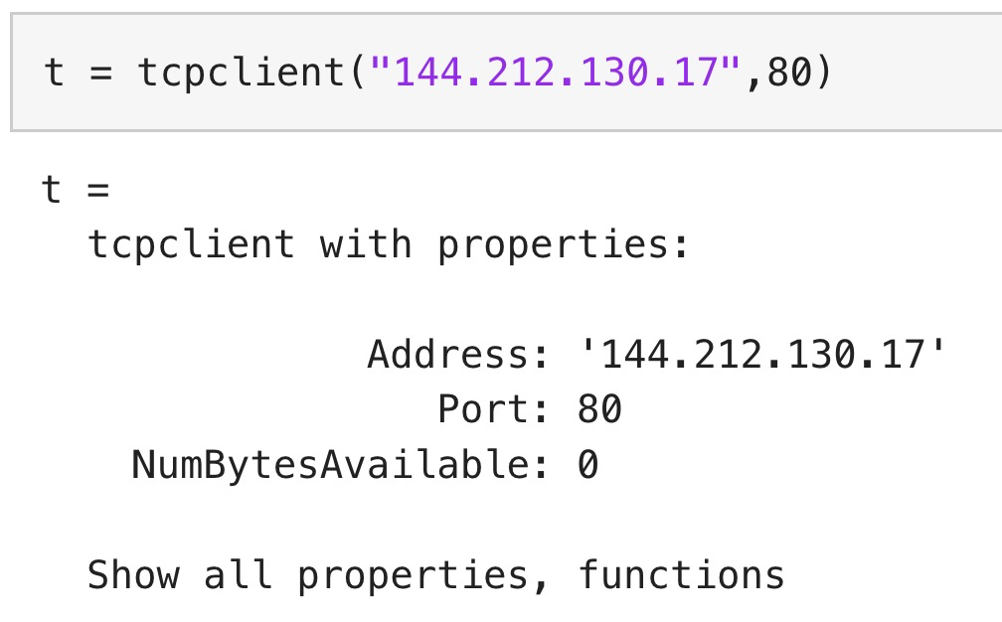
Create a TCP/IP connection to a server
1. Creation: create a TCP/IP connection to a server
Create Object Using IP Address
Create the TCP/IP object t using the IP address shown and port 80.

Slide 28
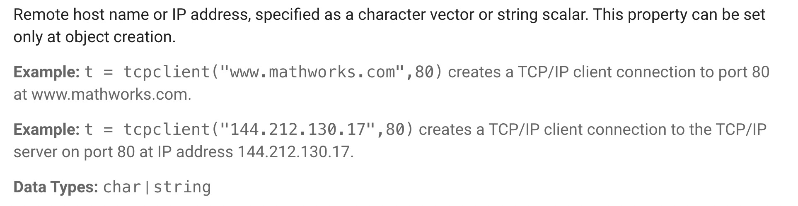


Create a TCP/IP connection to a server
2. Properties: object creation properties
Address — Remote host name or IP address

Slide 29
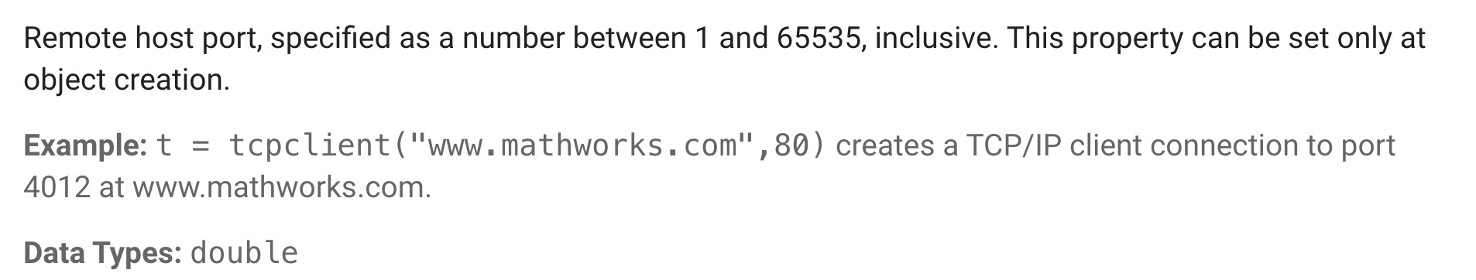


Create a TCP/IP connection to a server
2. Properties: object creation properties
Port — Remote host port

Slide 30
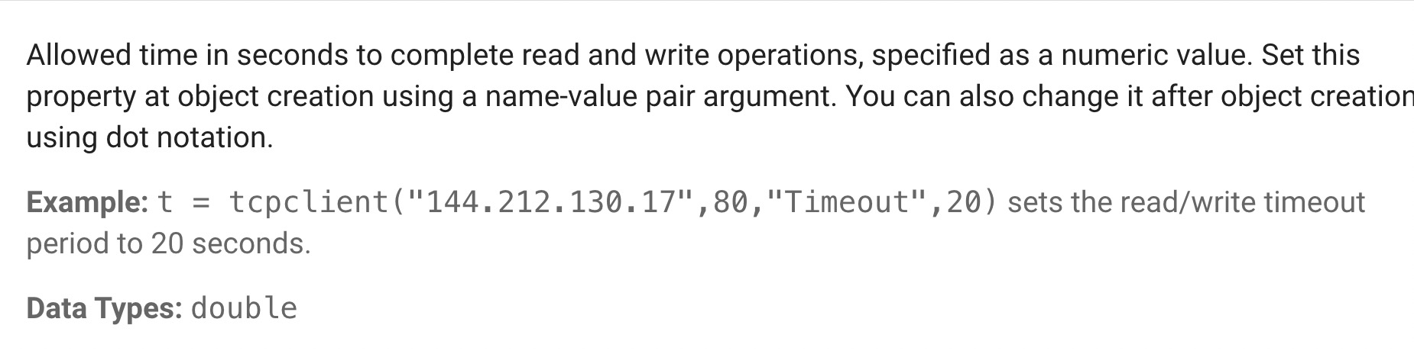


Create a TCP/IP connection to a server
2. Properties: object creation properties
Timeout — Allowed time to complete operations

Slide 31
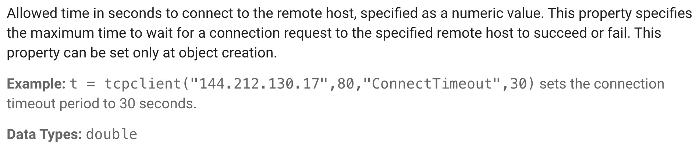
Create a TCP/IP connection to a server
2. Properties: object creation properties
ConnectTimeout — Allowed time to connect to remote host

Slide 32
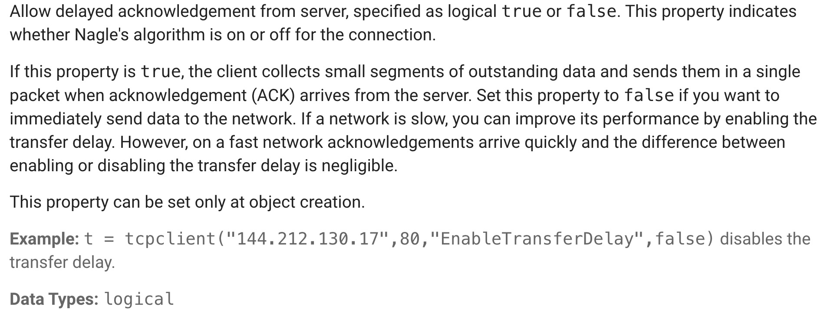
Create a TCP/IP connection to a server
2. Properties: object creation properties
EnableTransferDelay

Slide 33
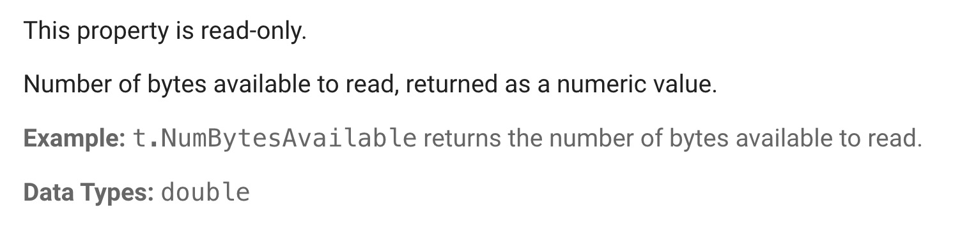


Create a TCP/IP connection to a server
3. Properties: Read and Write Properties
NumBytesAvailable — Number of bytes available to read

Slide 34
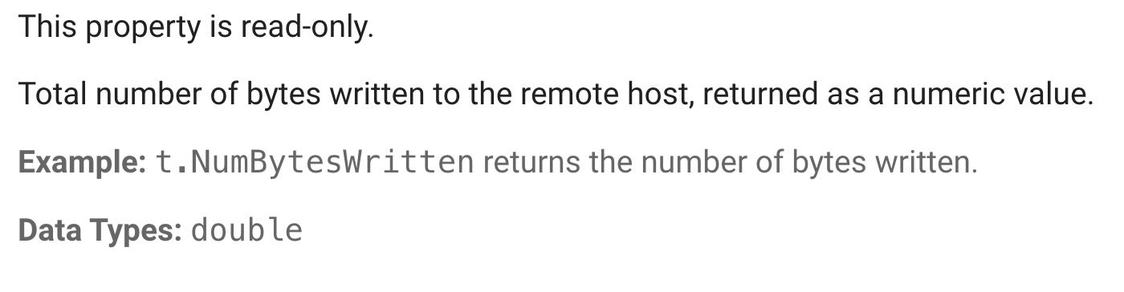
Create a TCP/IP connection to a server
3. Properties: Read and Write Properties
NumBytesWritten — Total number of bytes written to remote host

Slide 35
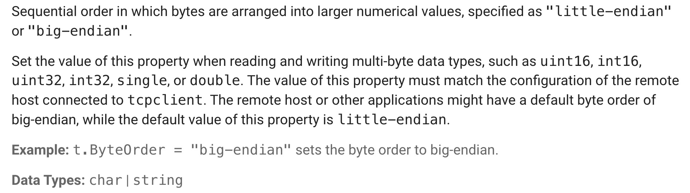
Create a TCP/IP connection to a server
3. Properties: Read and Write Properties
ByteOrder — Sequential order of bytes
Endianness means that the bytes in computer memory are read in a certain order.

Slide 36
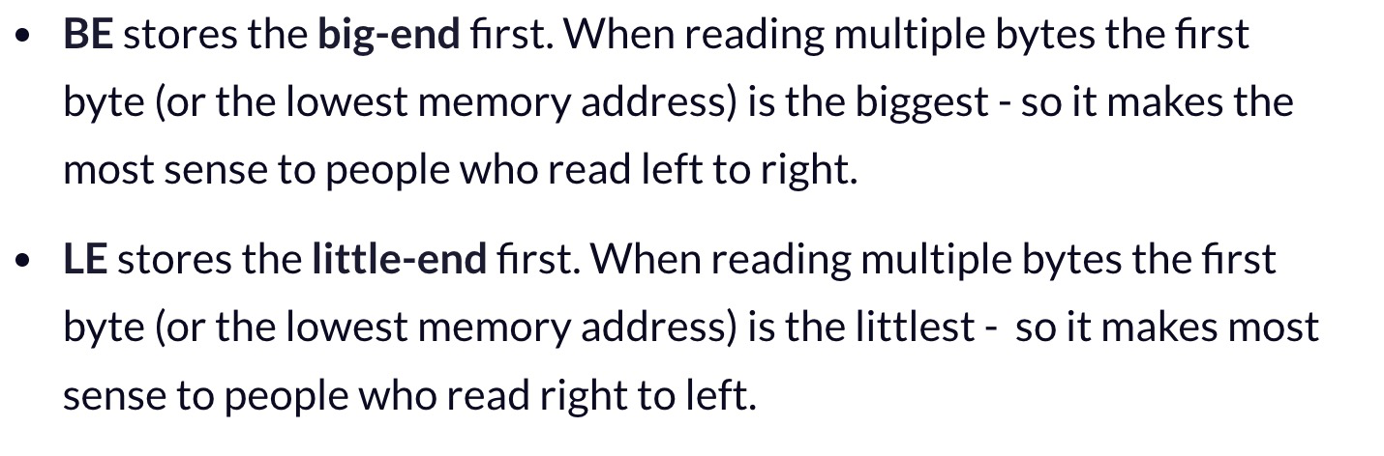
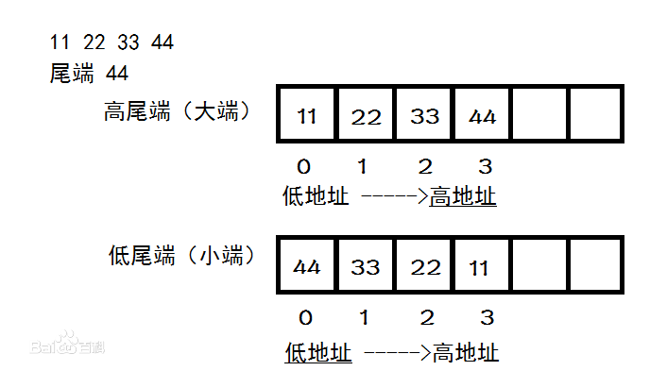


Create a TCP/IP connection to a server
3. Properties: Read and Write Properties
ByteOrder — Sequential order of bytes
Endianness means that the bytes in computer memory are read in a certain order.

Slide 37
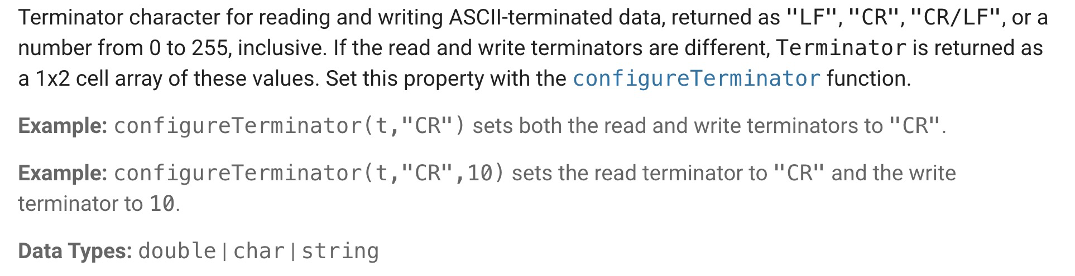


Create a TCP/IP connection to a server
3. Properties: Read and Write Properties
Terminator — Terminator character for data

Slide 38
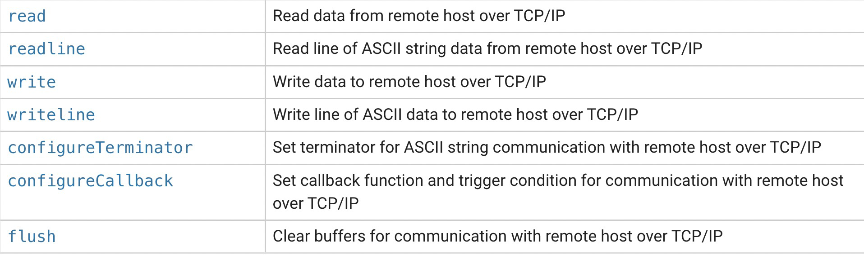



Create a TCP/IP connection to a server
Object functions

Slide 39
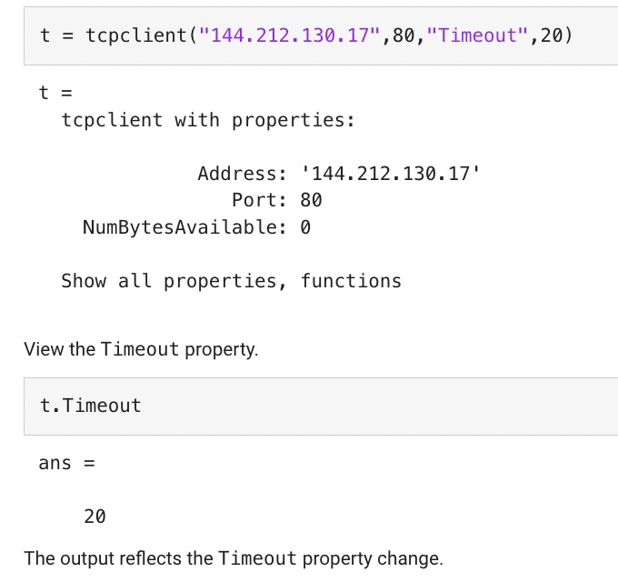

Configure the connection if necessary
1. Set Timeout Property
The Timeout parameter specifies the waiting time to complete read and write operations in seconds, and the default value is 10.
You can change the value either during object creation or after you create the object.

Slide 40
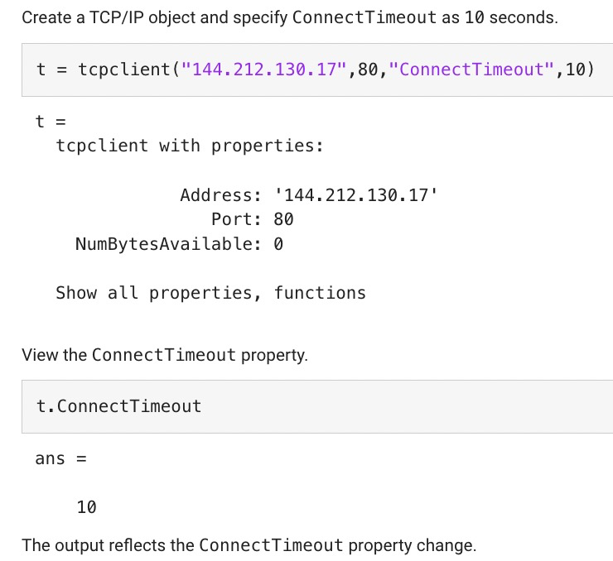

Configure the connection if necessary
2. Set ConnectTimeout Property
The ConnectTimeout parameter specifies the maximum time in seconds to wait for a connection request to the specified remote host to succeed or fail. The value must be greater than or equal to 1.
If you do not specify ConnectTimeout, it has the default value of Inf.

Slide 41
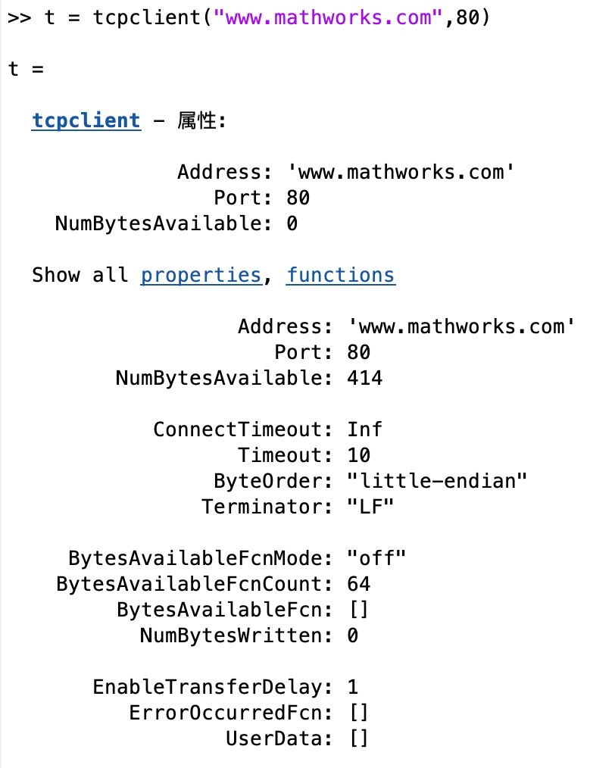






Configure the connection if necessary
3. View TCP/IP Object Properties
After you create a tcpclient object, you can view a full list of properties and their values. Click properties in the tcpclient output.

Slide 42
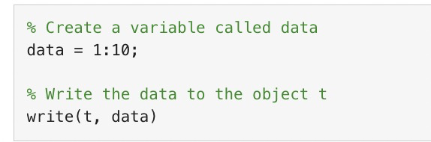



Perform read and write operations
1. Write Data
The write function synchronously writes data to the remote host connected to the tcpclient object.
First specify the data, then write the data. The function waits until the specified number of values is written to the remote host.

Slide 43
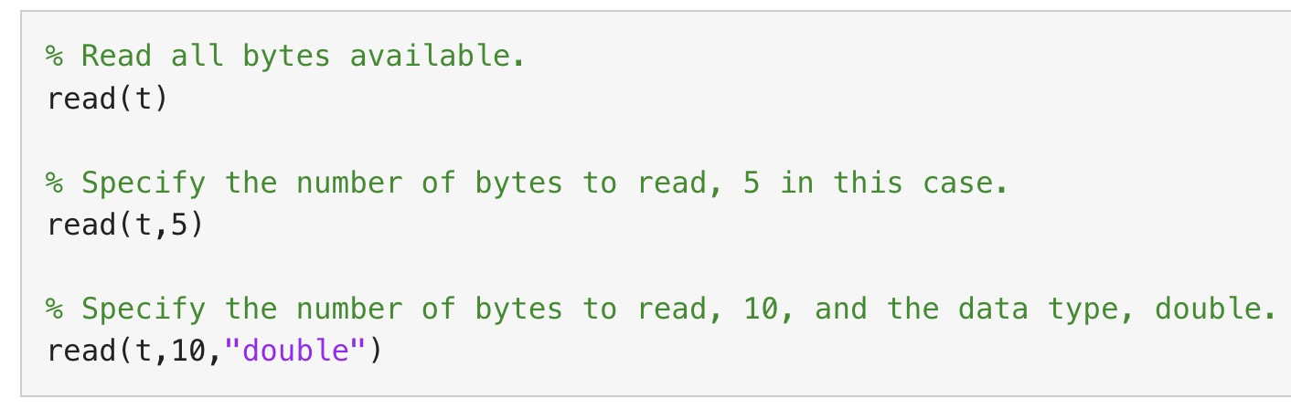




Perform read and write operations
2. Read Data
The read function synchronously reads data from the remote host connected to the tcpclient object and returns the data. Three options:
Read all bytes available (no arguments).
Optionally specify the number of bytes to read.
Optionally specify the data type.
If you do not specify a size, the default read uses the BytesAvailable property value, which is equal to the number of bytes available in the input buffer.

Slide 44

Perform read and write operations
Note:
For any read or write operation, the data type is converted to uint8 (unsigned integer numbers) for the data transfer. It is then converted back to the data type you set if you specified another data type.
Example 1: Write and Read uint8 Data from Remote Host
Example 2: Acquire Data from a remote server
Example 3: Read Page from Website
Example 4: Communicate Between a TCP/IP Client and Server

Slide 45
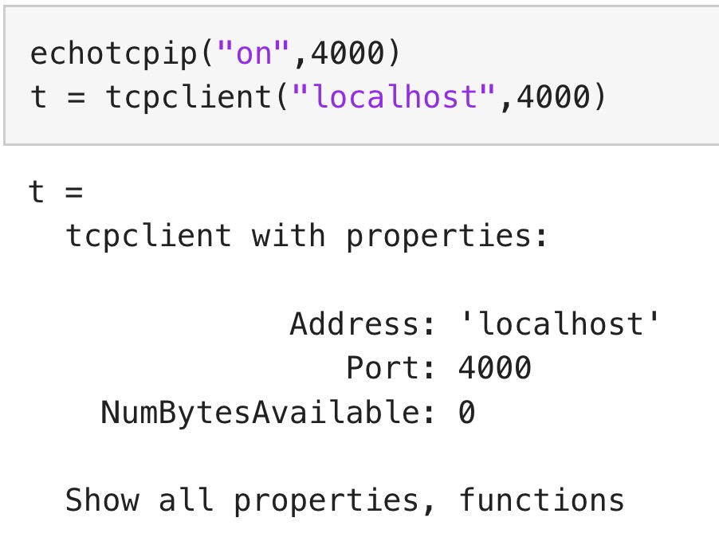
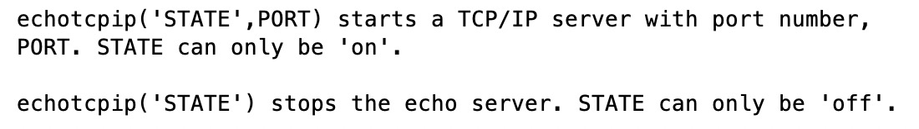





Example 1: Write and Read uint8 Data from Remote Host
1. Create a TCP/IP client connection called t, connecting to a TCP/IP echo server with port 4000. To do so, you must have an echotcpip server running on port 4000 (start or stop a TCP/IP echo server via echotcpip).

Slide 46
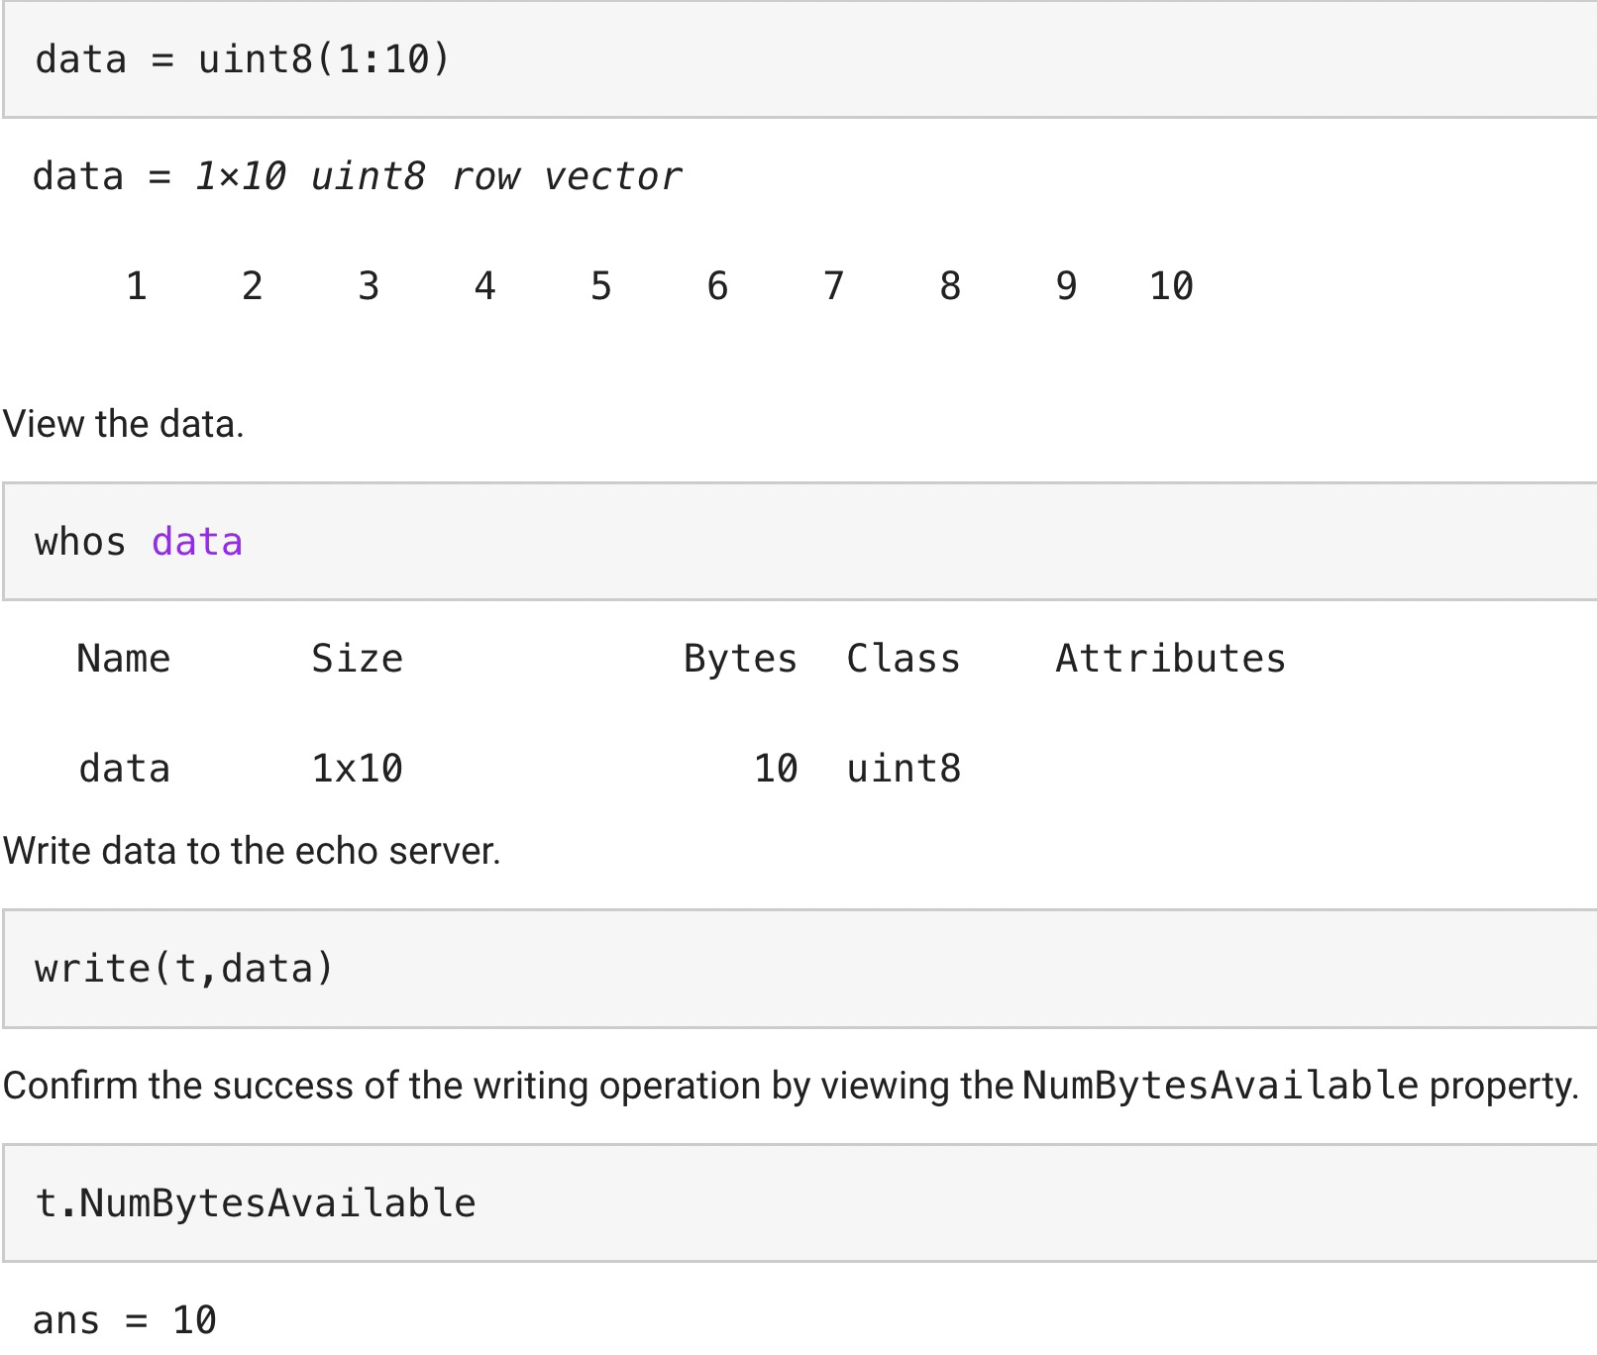



Example 1: Write and Read uint8 Data from Remote Host
2. The write function synchronously writes data to the remote host connected to t. First specify the data and then write the data. Assign 10 bytes of uint8 data to the variable data:

Slide 47
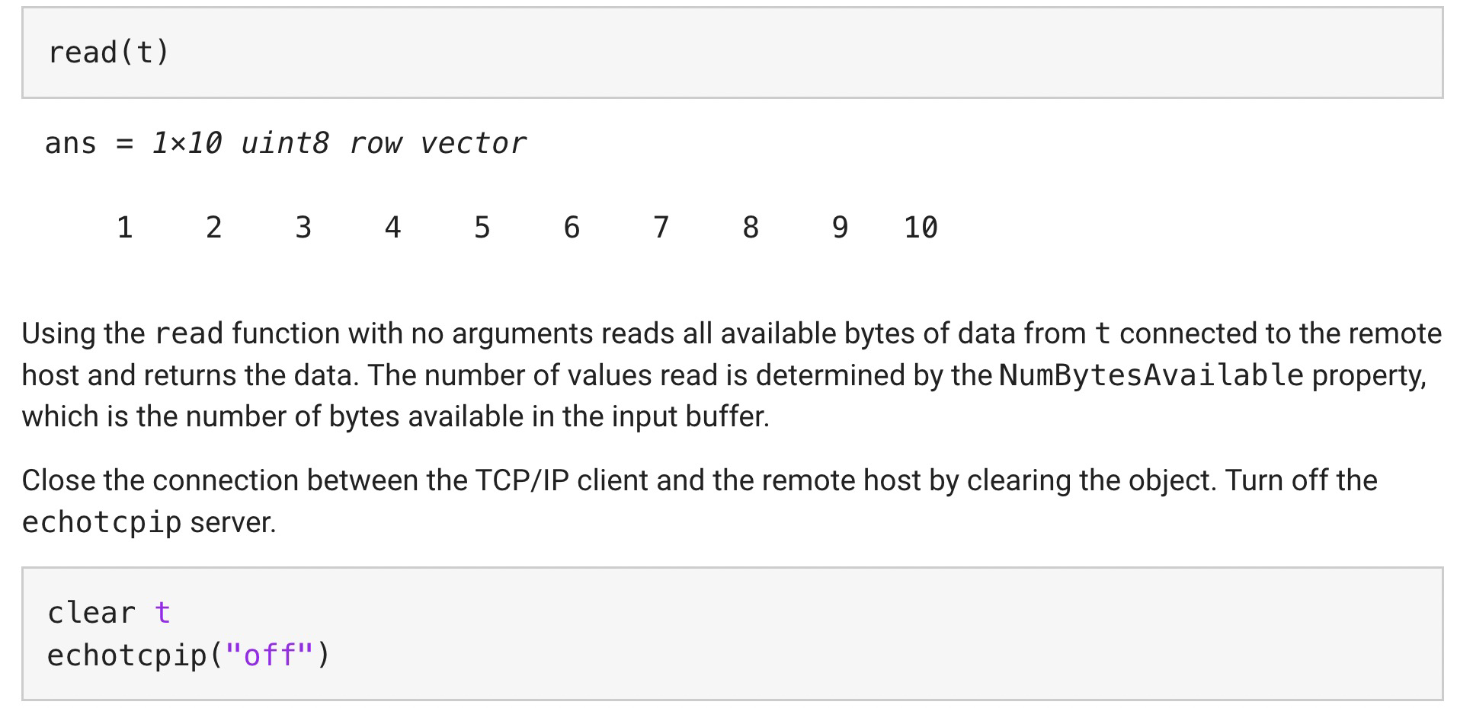


Example 1: Write and Read uint8 Data from Remote Host
3. Since the client is connected to an echo server, the data you write to the server is returned to the client. Read all the bytes of data available.

Slide 48
Example 1: Write and Read uint8 Data from Remote Host
Try it on your computer
and see what happens !?

Slide 49
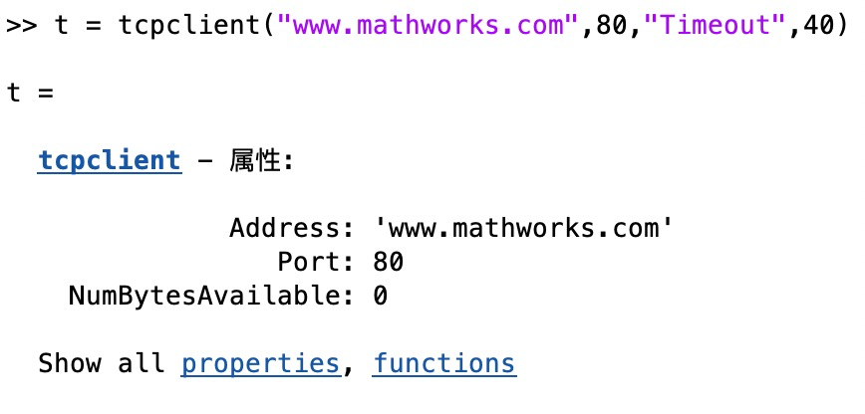


Example 2: Acquire data from remote server
Note:
One of the primary uses of TCP/IP communication is to acquire data from a server. This example shows how to acquire and plot data from a remote server.
Procedure:
Step 1: Create the tcpclient object using the address (e.g., mathworks) and port.
Set “Timeout” field to guarantee the read() function

Slide 50
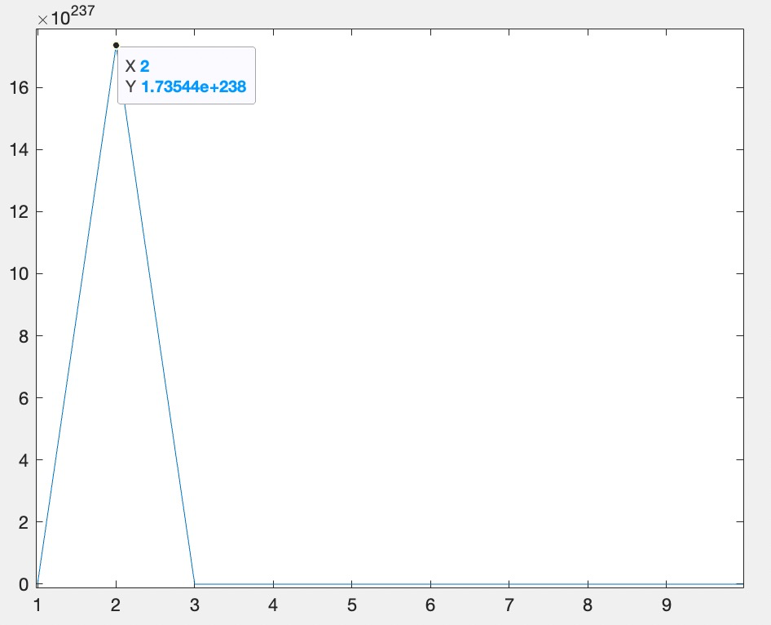
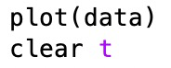


Example 2: Acquire data from remote server
Procedure:
Step 2: Acquire data using the read function. Specify the number of bytes to read as 10, and the data type as double.
Step 3: Plot the data, then close the connection between the TCP/IP client object and the remote host by clearing the object.

Slide 51
Example 2: Acquire data from remote server
Try it on your computer
and see what happens !?

Slide 52
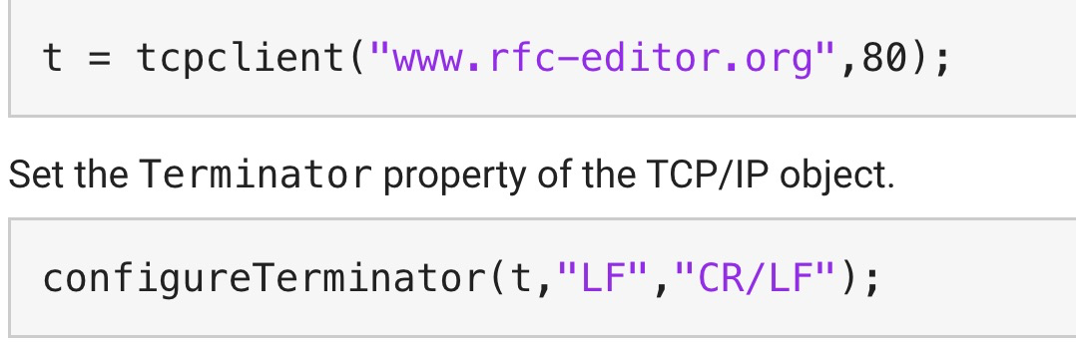
Example 3: Read Page from Website
Note:
In this example, you read a page from the RFC Editor Web site using a TCP/IP object.
Procedure:
Step 1: Create a TCP/IP object. Port 80 is the standard port for web servers.

Slide 53
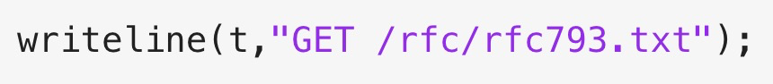
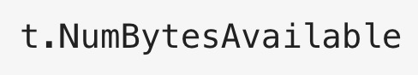








Example 3: Read Page from Website
Procedure:
Step 2: You can now communicate with the server using the writeline and readline functions.
To ask a web server to send a web page, use the GET command. You can ask for a text file from the RFC Editor Web site using 'GET (path/filename)'.
The server receives the command and sends back the web page. You can see if any data was sent back by looking at the NumBytesAvailable property of the object.
Now you can start to read the web page data. By default, readline reads one line at a time.

Slide 54
Example 4: Communicate Between a TCP/IP Client and Server
Note:
You can run this example three different ways:
Within a single MATLAB session.
Between two MATLAB sessions on the same computer.
Between two MATLAB sessions on different computers that are part of the same subnet.
Here, we use the first way which is more easier!
Creat client session
Creat server session
Define callback functions

Slide 55




Example 4: Communicate Between a TCP/IP Client and Server
Procedure of creat server session:
In this session, create a tcpserver object that listens for client connection requests. It sends data after a client connects to it. It also uses the callback functionality enabled by the configureCallback method to read data sent by the client.
Step 1: Find Host Name and Address
Find the host name and address of the machine where the server is created. The client uses this address to connect to the server.

Slide 56

Example 4: Communicate Between a TCP/IP Client and Server
Procedure of creat server session:
Step 2: Create Server
Create the tcpserver object using the address of the machine and port 4500 (can be modified).
Create a callback function called connectionFcn to write data when a TCP/IP client connects to the server. Set the ConnectionChangedFcn property to the callback function connectionFcn.

Slide 57

Example 4: Communicate Between a TCP/IP Client and Server
Procedure of creat server session:
Step 3: Read Binary Data Using Byte Callback Mode
Create a callback function called readDataFcn to read data each time the specified bytes of data are available. Store the read data in the UserData property of tcpserver object.
Set the callback function to trigger each time 7688 bytes of data are received.

Slide 58



Example 4: Communicate Between a TCP/IP Client and Server
Procedure of creat client session:
In this session, create a tcpclient object to connect to the server. The client reads data sent from the server. It then sends the data it read back to the server.
Step 1: Create Client
Create a tcpclient instance and set the timeout to five seconds.

Slide 59


Example 4: Communicate Between a TCP/IP Client and Server
Procedure of creat client session:
Step 2: Read Data and Display
Read data sent by the server. Reshape the data array and plot it.

Slide 60



Example 4: Communicate Between a TCP/IP Client and Server
Procedure of creat client session:
Step 3: Write Data
Write data to the server.
Step 4: Clear the Client
Clear the tcpclient instance.

Slide 61


Example 4: Communicate Between a TCP/IP Client and Server
Callback Functions
Function 1: Connection Callback Function to Write Binary Data
This function calls write to write data to the connected TCP/IP client.

Slide 62


Example 4: Communicate Between a TCP/IP Client and Server
Callback Functions
Function 2: Data Available Callback Function to Read Binary Data
This function calls read to read BytesAvailableFcnCount number of bytes of data.

Slide 63
Example 4: Communicate Between a TCP/IP Client and Server
Try it on your computer
and see what happens !?

Slide 64
Goals
1. Matlab overview
2. TCP Connections via Matlab
3. UDP Connections via Matlab

Slide 65
UDP Communication Overview
Connectionless
UDP is a connectionless protocol. In TCP/IP, the two ends of the communication link must be connected at all times during the communication.
In contrast, an application using UDP prepares a packet and sends it to the receiver's address without first checking to see if the receiver is ready to receive a packet. If the receiving end is not ready to receive a packet, the packet is lost.

Slide 66
UDP Communication Overview
Packet-oriented
UDP is a packet-oriented protocol where the application itself divides the data into packets and sends them to the other end. The other end does not have to reassemble the data into a stream.
Unreliable
UDP sends the packets and does not keep track of them. Thus, if packets arrive out of sequence, or are lost in transmission, the receiving end (or the sending end) has no way of knowing.

Slide 67
Create a UDP Object and View Properties
udpport
Create a UDP object with the udpport function. udpport does not require the name of the remote host as an input argument. Although UDP is a stateless connection, opening a UDP object with an invalid port number generates an error.
You can configure property values during object creation, such as the LocalPort property if you will use the object to read data from the instrument.

Slide 68

Create a UDP Object and View Properties
Create a Byte-Type UDP Object
Create a UDP object associated with local port 3533. This creates a byte-type udpport object.

Slide 69

Create a UDP Object and View Properties
Create a Datagram-Type UDP Object
You can also create a datagram-type udpport object by specifying the object type during object creation.

Slide 70




Create a UDP Object and View Properties
Enable Port Sharing over UDP
UDP ports can be shared by other applications to allow for multiple applications to listen to the UDP datagrams on that port.
You can bind a UDP object to a specific LocalPort number, and in another application bind a UDP socket to that same local port number so both can receive UDP broadcast or multicast data.

Slide 71


Communicate Between Two UDP Sessions
Note
This example shows how to send data over the UDP between two sessions on the same computer using the udpport function.
First MATLAB session
Step 1: Create udpport Instance
Create a udpport instance and bind to port 2020.

Slide 72

Communicate Between Two UDP Sessions
First MATLAB session
Step 2: Prepare Callback Function
Configure the callback function to read data received using the configureCallback function. This callback function will trigger whenever a terminator is received.

Slide 73


Communicate Between Two UDP Sessions
First MATLAB session
Step 2: Prepare Callback Function
The sendAcknowledgement callback function sends an ACK string back to the udpport instance in the second session when it receives data.

Slide 74


Communicate Between Two UDP Sessions
First MATLAB session
Step 2: Prepare Callback Function
The sendAcknowledgement callback function sends an ACK string back to the udpport instance in the second session when it receives data.

Slide 75

Communicate Between Two UDP Sessions
Second MATLAB session
Step 1: Create udpport Instance
Create a udpport instance and bind to port 3030.

Slide 76

Communicate Between Two UDP Sessions
Second MATLAB session
Step 2: Prepare Callback Function
Configure the callback function readAcknowledgement to read data received using the configureCallback function. This callback function is triggered when a terminator is received. The terminator value used for this example is "CR/LF".

Slide 77


Communicate Between Two UDP Sessions
Second MATLAB session
Step 2: Prepare Callback Function
Set up the callback function readAcknowledgement to trigger when the assigned terminator is received.

Slide 78

Communicate Between Two UDP Sessions
Second MATLAB session
Step 2: Prepare Callback Function
The BytesAvailableFcn property should be now set to the callback function, and the BytesAvailableFcnMode set to "terminator".

Slide 79

Communicate Between Two UDP Sessions
Send Command to First Session
Step 1: Send a "START" command to the udpport instance uFirst on the first MATLAB session using writeline.
uFirst is bound to port 2020. writeline automatically appends the "START" command with the Terminator "CR/LF".

Slide 80

Communicate Between Two UDP Sessions
Send Command to First Session
Step 2: Send another command to the same destination address and destination port.
The "STOP" command is automatically appended with the Terminator "CR/LF".

Slide 81


Communicate Between Two UDP Sessions
Clear udpport

Slide 82
Communicate Between Two UDP Sessions
Try it on your computer
and see what happens !?

Slide 83
Thank you for your listening!
Q&A and Discussions!
Final examination:
Prepare demo & talk (8~10mins) for the next lesson (you need to demostrate how you do this step-by-step) (50%)
choose one of them (included but NOT limited!)
Analyzing HTTP/TCP (handshake) /UDP/... using Wireshark/...
Realizing the TCP/UDP/... communication example via Matlab/python/C, C++...
Analyzing MAC/... protocol using Matlab/NS/...
Other experiment that is related to our course
Submit a report for your demo, and present your own opinions on computer networks, analysis and simulations (40%)
Attendance record (10%)

